Slide 1
January Internship at the ExCITe Center
Tate Park

Slide 2
Background

Slide 3

Music and Entertainment Technology Laboratory (MET-Lab)

Slide 4
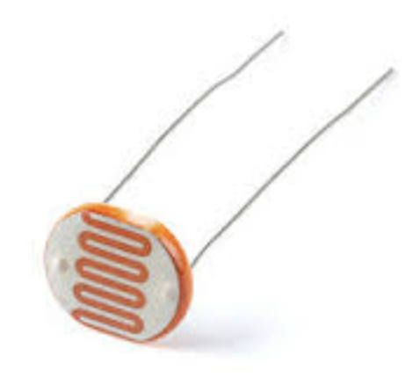
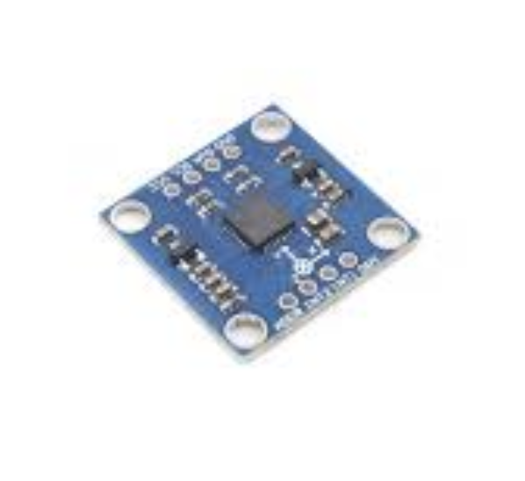
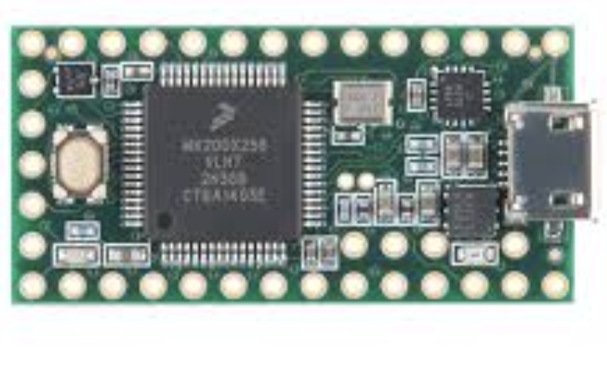
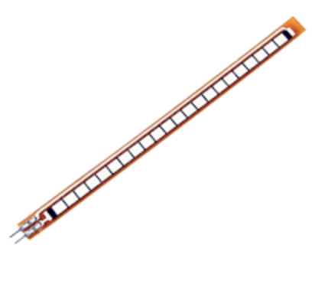
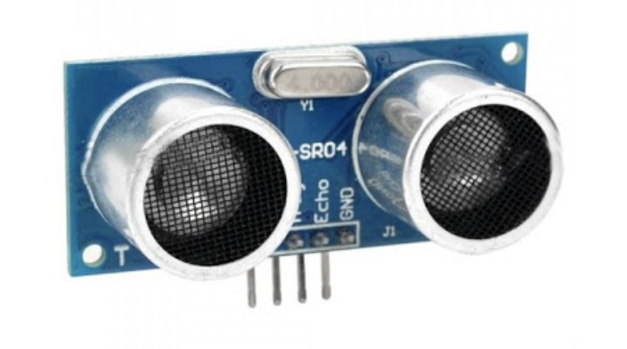
acceleration
Light
bend
distance

Slide 5
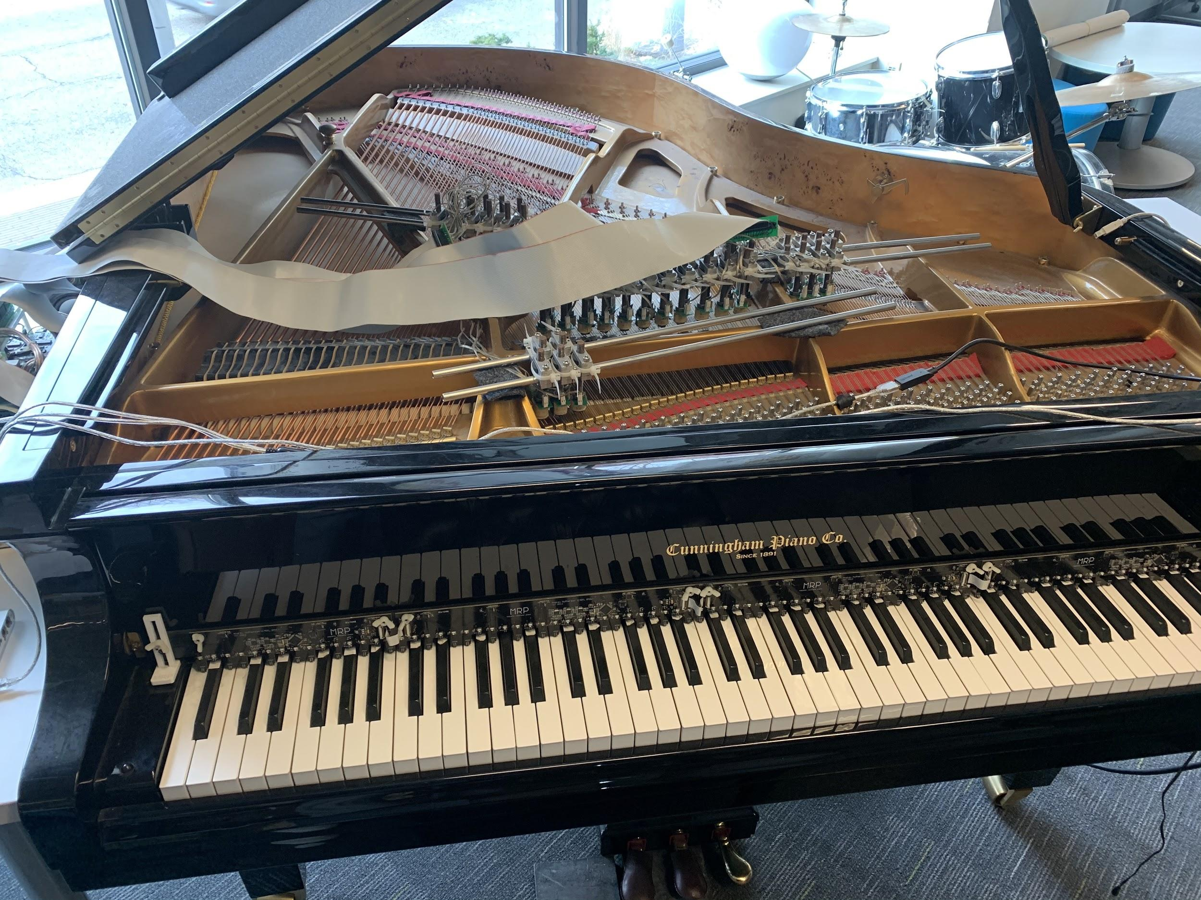
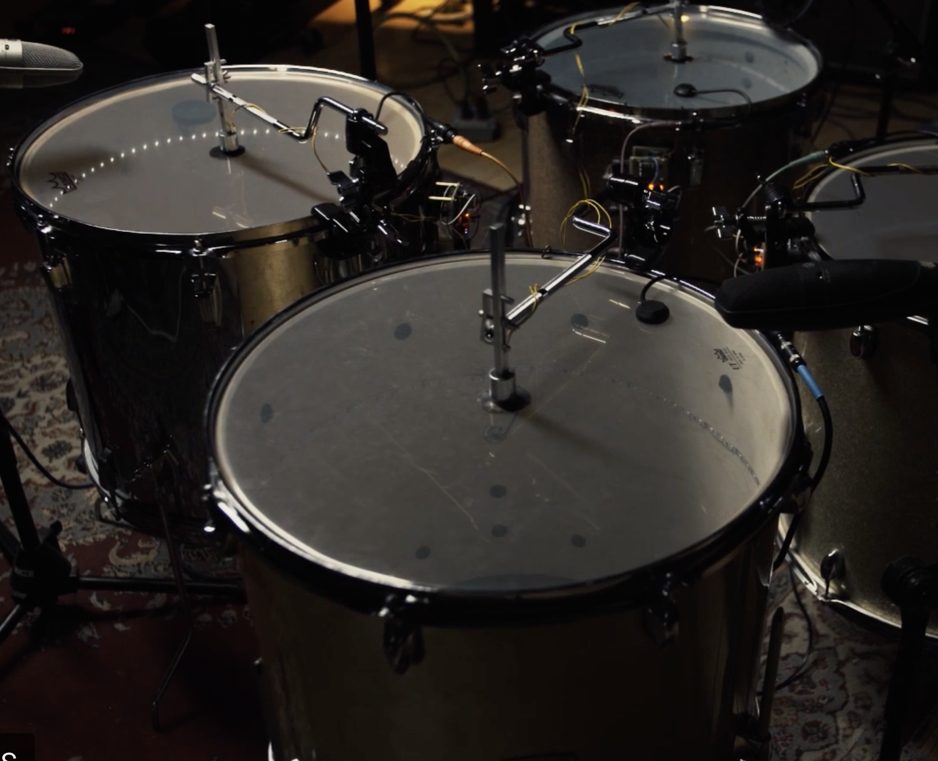
Long Term Project: Make a new “instrument”

Slide 6
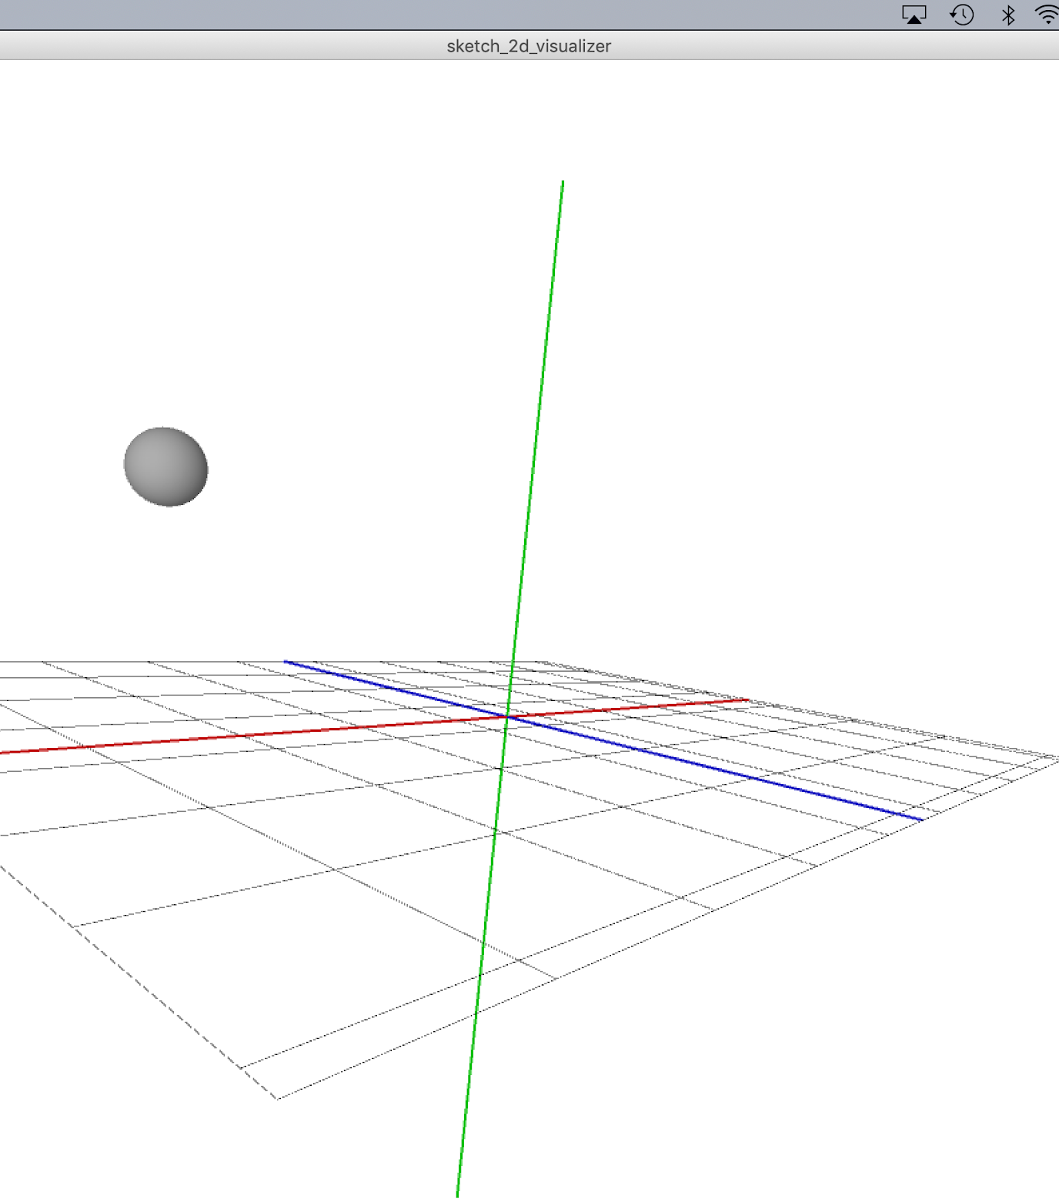
Tracking and
mapping an
object in 3D

Slide 7
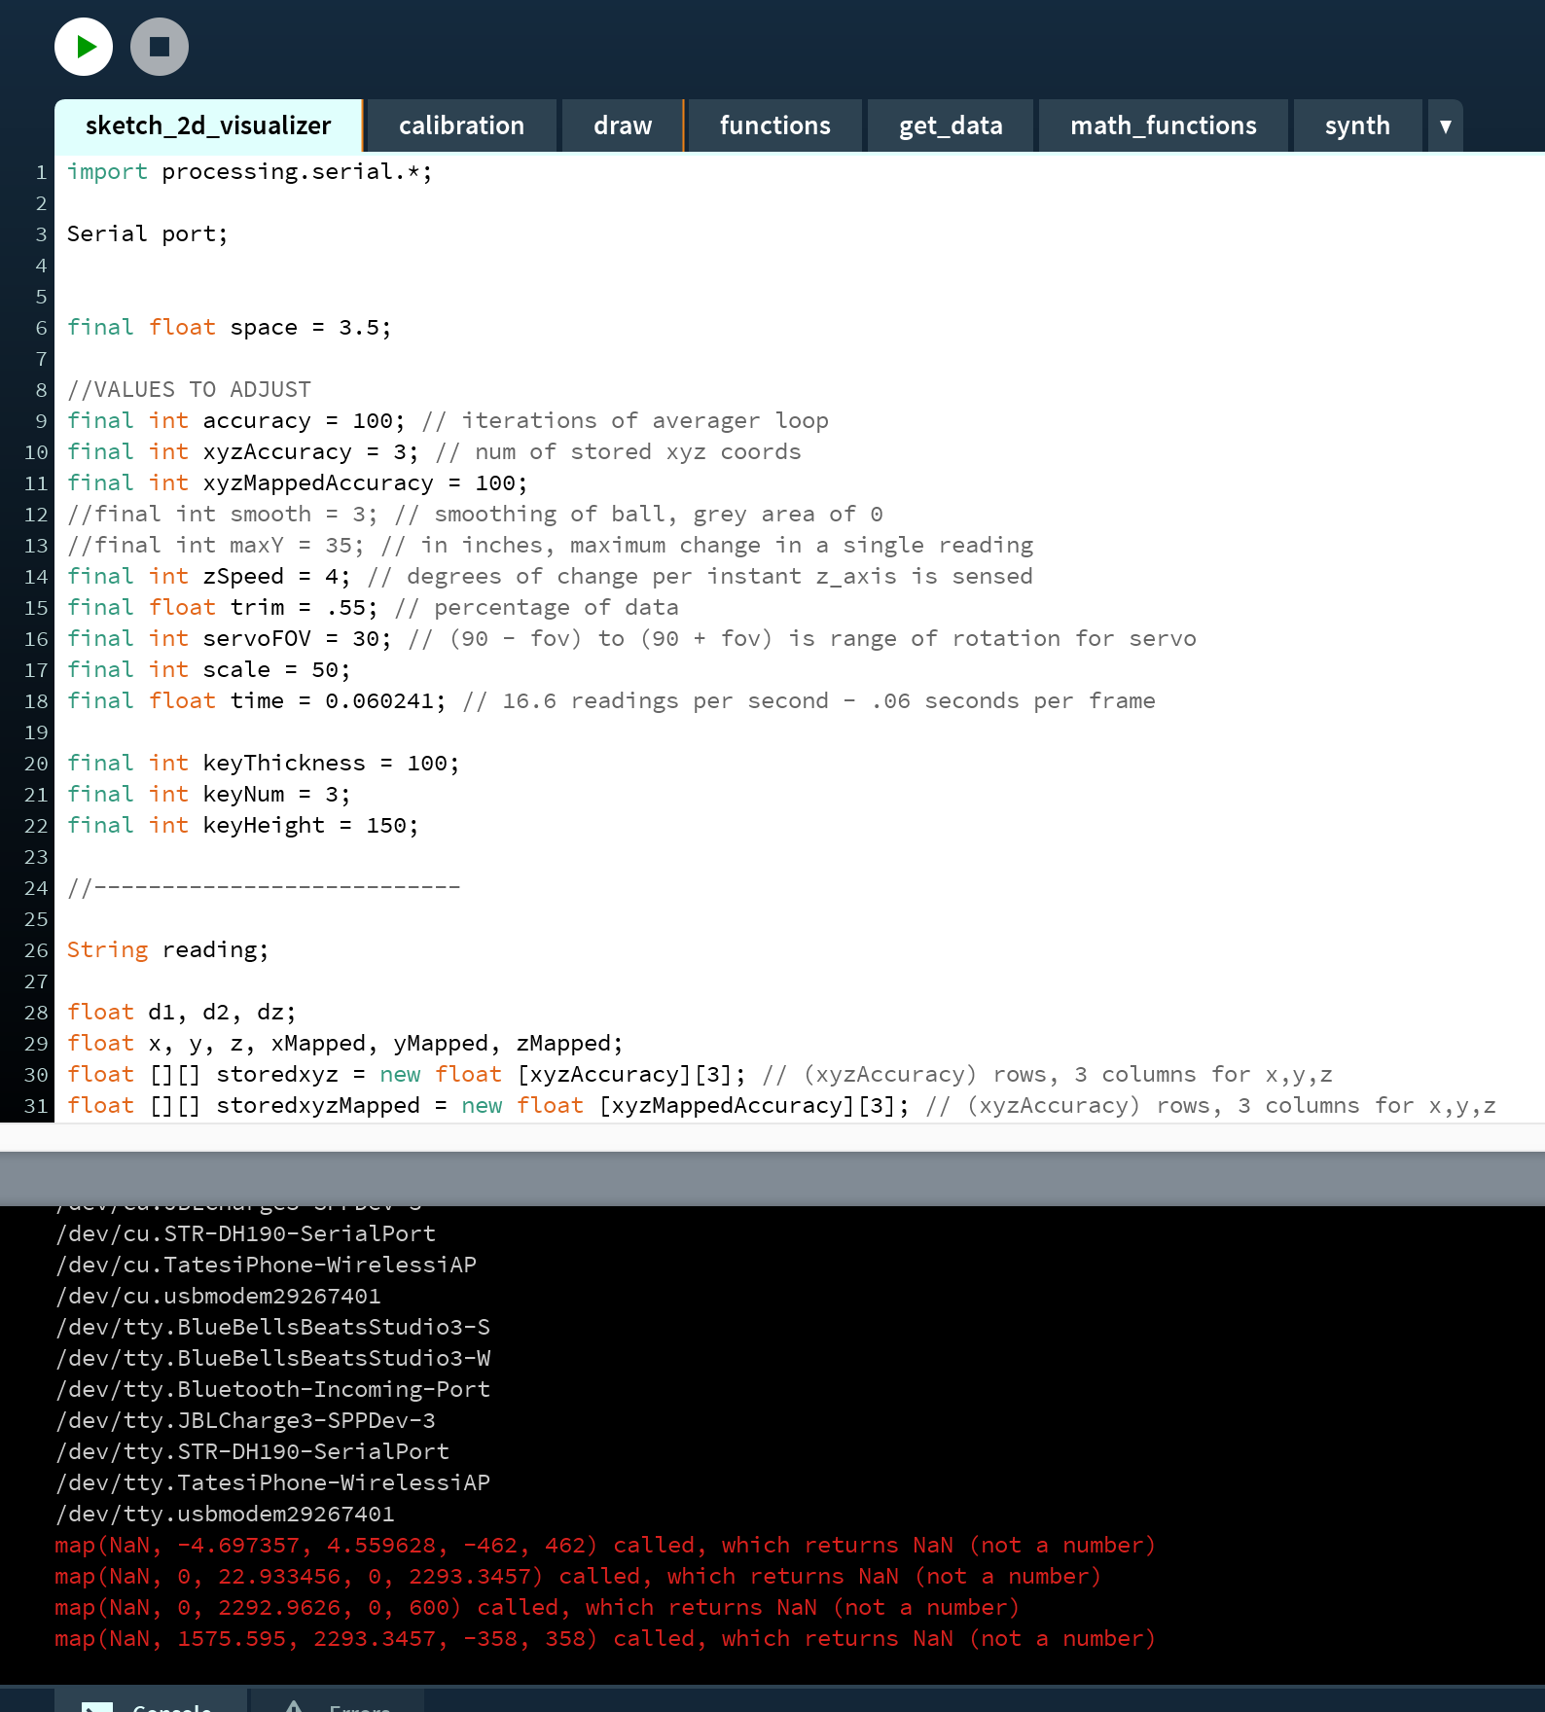
Tasks I did:
Debugging
Researching
Applying math
Trial and error

Slide 8
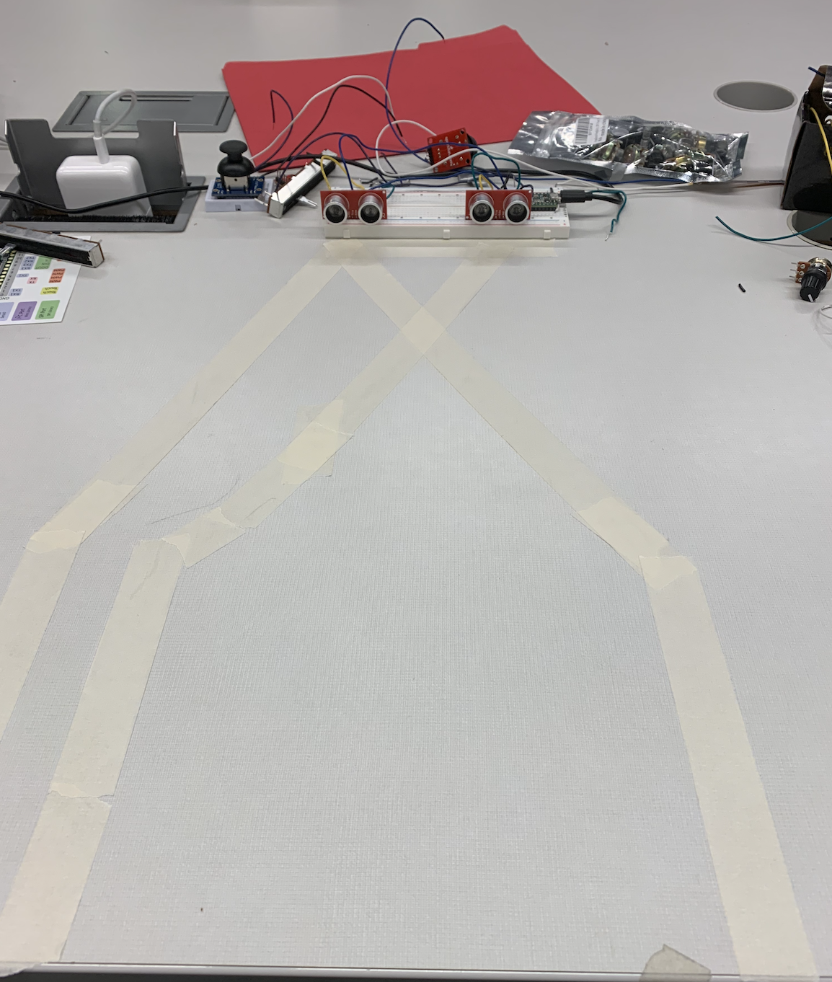
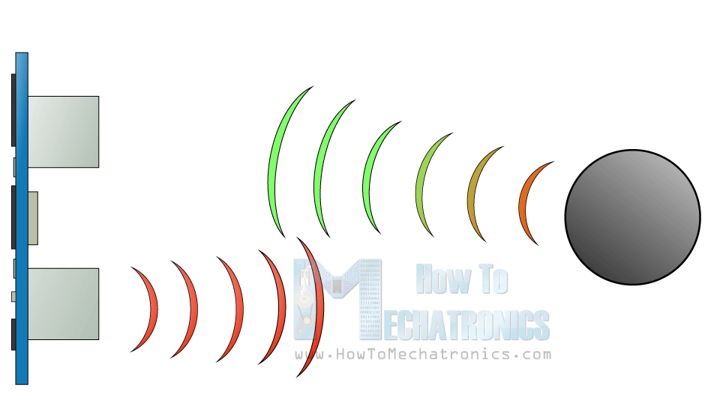

known distance
distance 2
distance 1

Slide 9
2 dimension values
angle of motor
motor

Slide 10
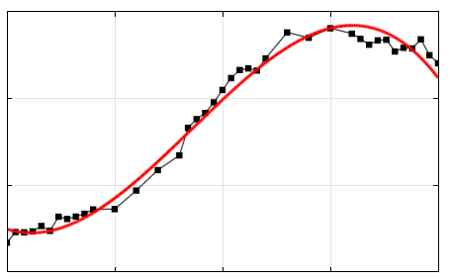
Interpreting “messy” data

Slide 11
Method | Accurate? | Fast? | Flexible?
Using raw data | No | Yes | Yes
Averaging past data points | Yes | No | Yes
Looking at a “slice” of past data points | OK | Yes | No
Normal Distribution | Yes | OK | Yes

Slide 12
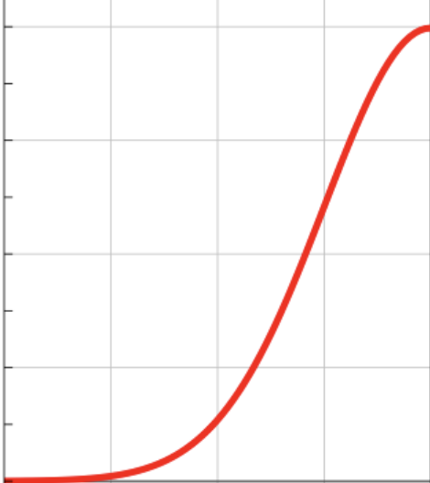
importance
Oldest number Newest number

Slide 13
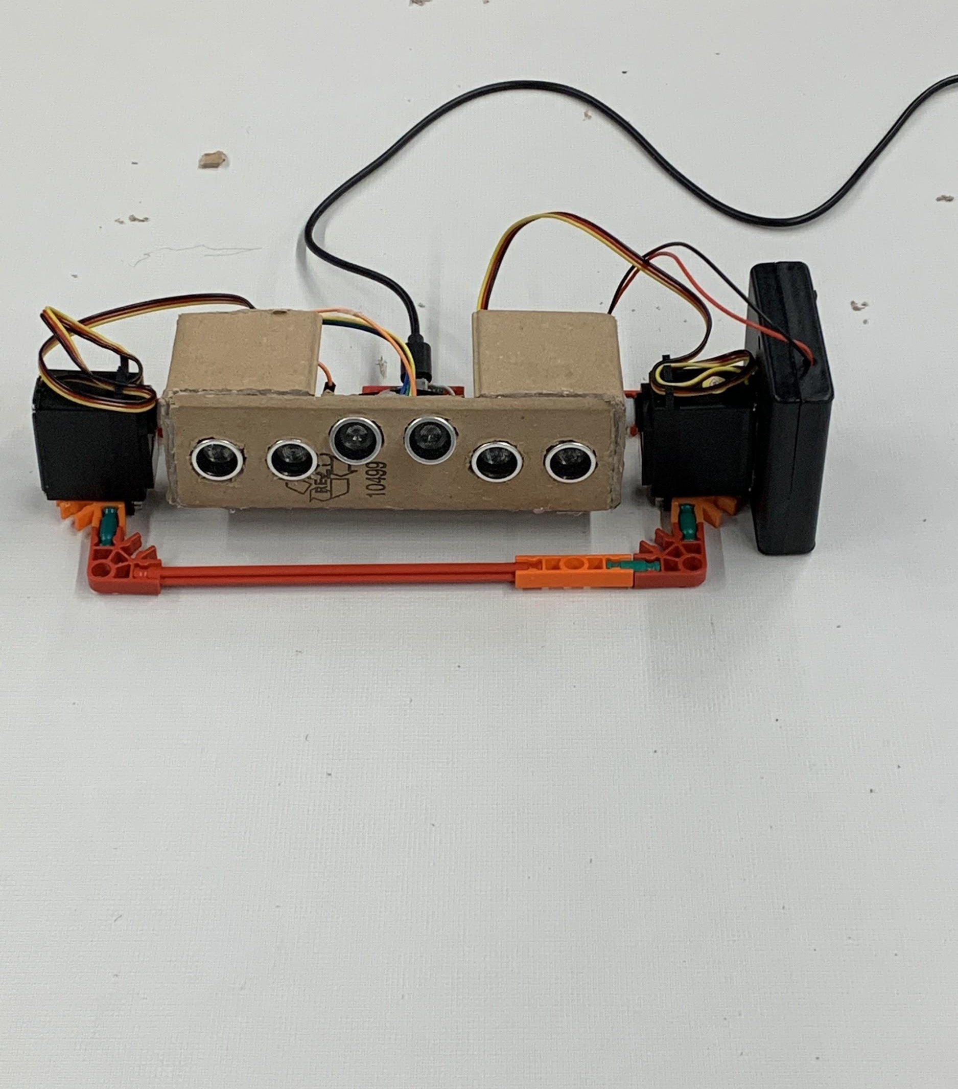
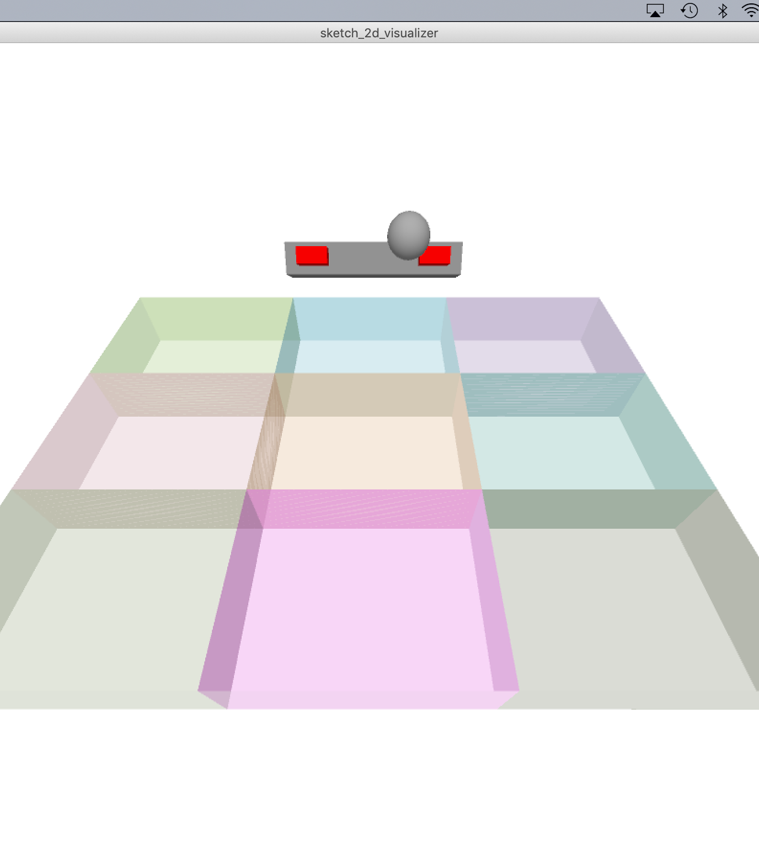

Slide 14
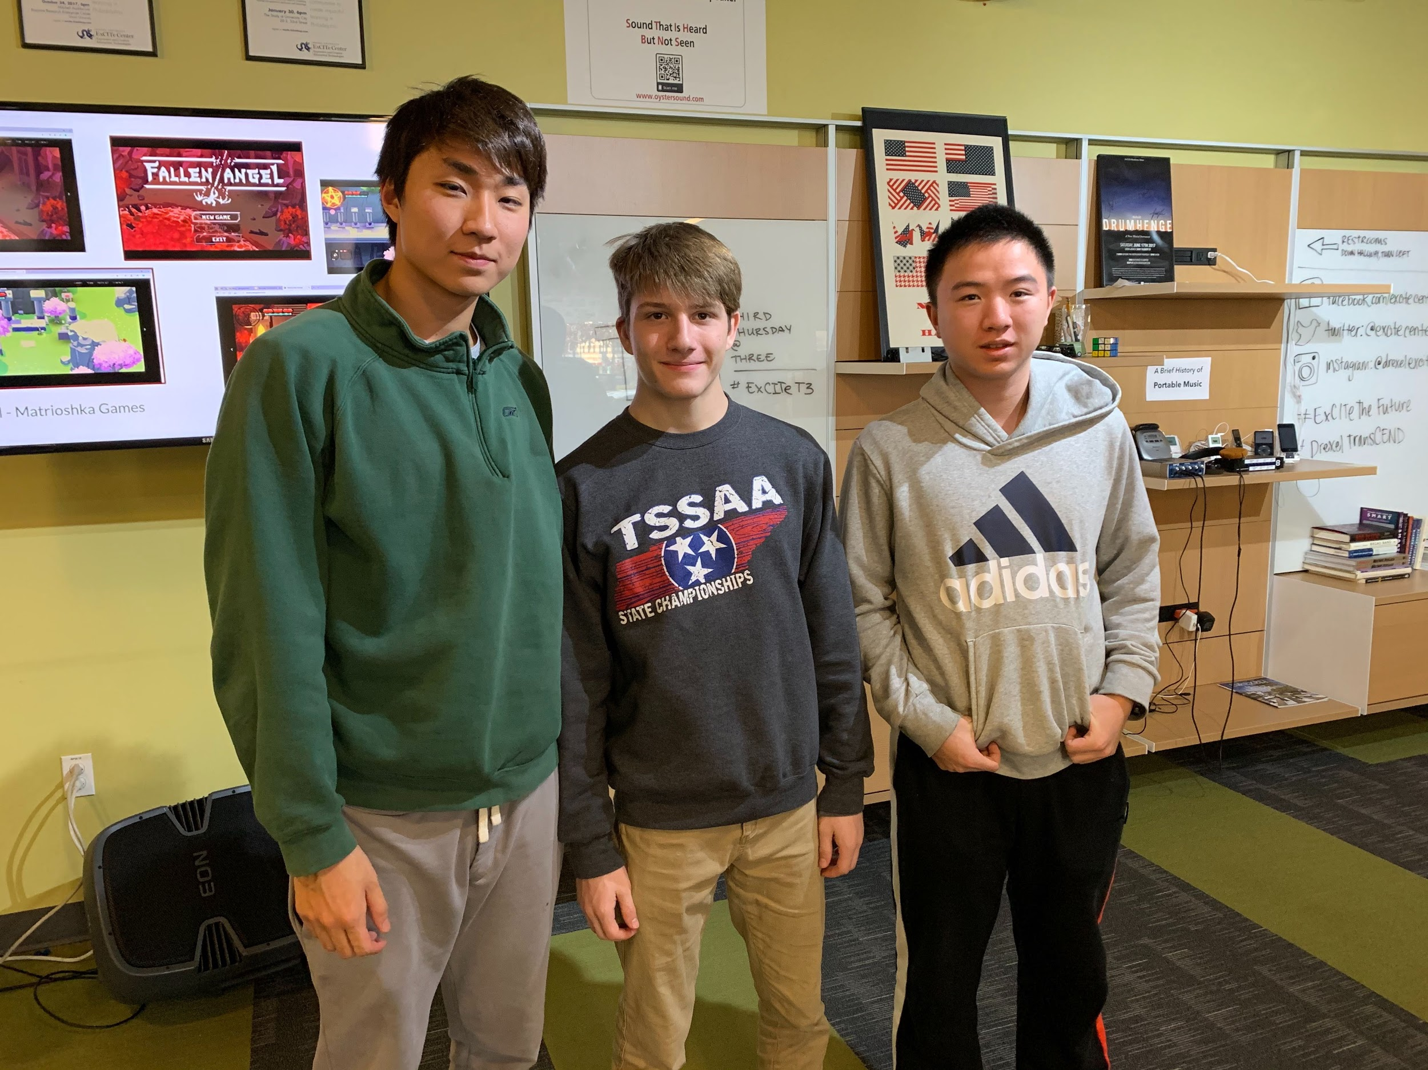
T3 Conference

Slide 15
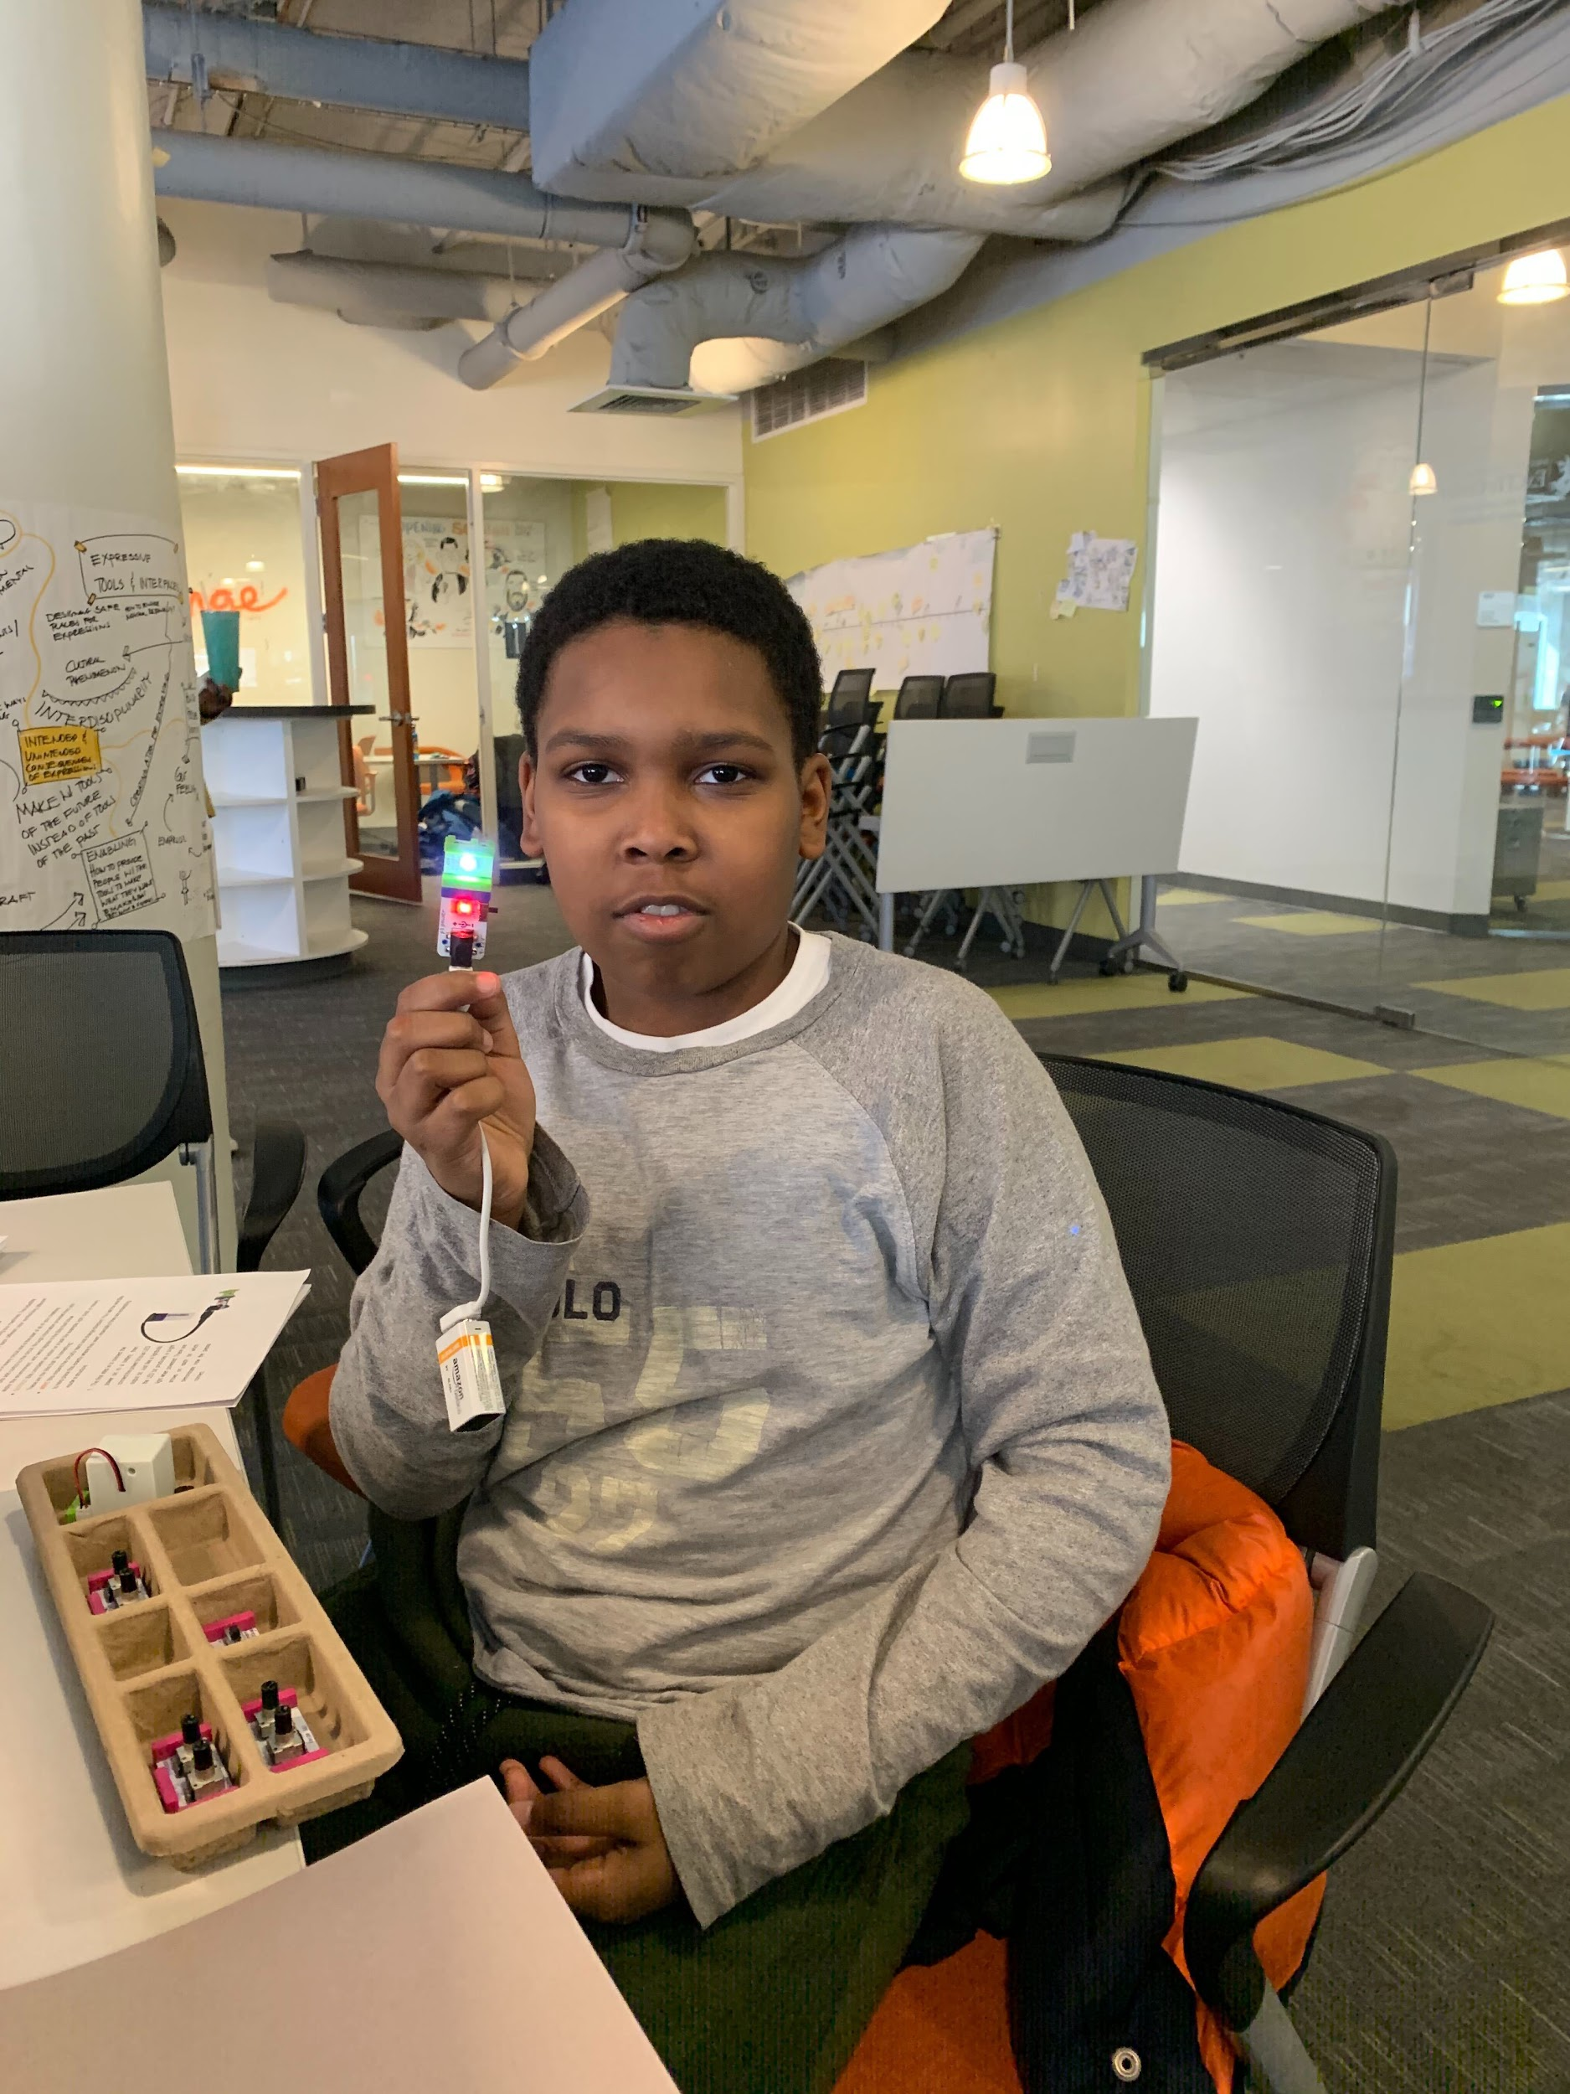
SLA Mentorship program
Notes:
Building robotic musical instruments: learning basics of robotics, designing

Slide 16
Skills learned:
Valuable coding and electrical engineering experience
Time management
Persistence and patience
What to do when you can’t solve a problem on your own

Slide 17
Takeaways

